Slide 1
Creating and manipulation of Array:
An array is a data structure that stores one or more similar type of values in a single value.
There are three different kind of arrays:
Numeric array − An array with a numeric index. Values are stored and accessed in linear fashion.
Associative array − An array with strings as index. This stores element values in association with key values rather than in a strict linear index order.
Multidimensional array − An array containing one or more arrays and values are accessed using multiple indices
Numeric Array :
It allow us to store multiple values of the same data type in a single variable without having to create separate variables for each value.
These arrays can store numbers, strings and any object but their index will be represented by numbers. By default array index starts from zero.

Slide 2
How to declare and initialize an array?
Accessing the elements
<?php
//creating an empty array
$empty_array = array();
//Method 1 to create an array
$my_array1 = array("apple", "banana", "mango", "peach");
//Method 2 to create an array
$my_array2[0] = "joe";
$my_array2[1] = "jonas";
$my_array2[2] = "nick";
//displaying output
echo $my_array1[0]."\n";
echo $my_array2[0];
?>
<?php
//Method 1 to create an array
$my_array1 = array("apple", "banana", "mango", "peach");
//accessing elements of array using their index
echo $my_array1[0],"\n";
echo $my_array1[1],"\n";
echo $my_array1[2],"\n";
echo $my_array1[3],"\n";
?>

Slide 3
Length of an array:
The length of an array, i.e, the number of elements present in the array can be counted using the in-built function count.
<?php
//Method 1 to create an array
$my_array1 = array("apple", "banana", "mango", "peach");
//calculating length of the array
echo "Length of the array is: ".count($my_array1);
?>

Slide 4
Associative arrays
Associative arrays are used to store key value pairs. For example, to store the marks of different subject of a student in an array, a numerically indexed array would not be the best choice. Instead, we could use the respective subject’s names as the keys in our associative array, and the value would be their respective marks gained.
<?php
/* First method to create an associate array. */
$student_one = array("Maths"=>95, "Physics"=>90,"Chemistry"=>96, "English"=>93,"Computer"=>98);
/* Second method to create an associate array. */
$student_two["Maths"] = 95;
$student_two["Physics"] = 90;
$student_two["Chemistry"] = 96;
$student_two["English"] = 93;
$student_two["Computer"] = 98;
/* Accessing the elements directly */
echo "Marks for student one is:\n";
echo "Maths:" . $student_two["Maths"], "\n";
echo "Physics:" . $student_two["Physics"], "\n";
echo "Chemistry:" . $student_two["Chemistry"], "\n";
echo "English:" . $student_one["English"], "\n";
echo "Computer:" . $student_one["Computer"], "\n";
?>

Slide 5
Traversing the Associative Array:
We can traverse associative arrays using loops. We can loop through the associative array in two ways. First by using for loop and secondly by using foreach.
Here array_keys() function is used to find indices names given to them and count() function is used to count number of indices in associative arrays.
<?php
$student_one = array("Maths"=>95, "Physics"=>90,"Chemistry"=>96, "English"=>93,"Computer"=>98);
echo "Looping using foreach: \n";
foreach ($student_one as $subject => $marks){
echo "Student one got ".$marks." in ".$subject."\n";
}
$subject = array_keys($student_one);
$len = count($student_one);
for($i=0; $i < $len; ++$i) {
echo $subject[$i] . ' ' . $student_one[$subject[$i]] . "\n";
}
?>

Slide 6
Creating an associative array of mixed types
<?php
/* Creating an associative array of mixed types */
$arr= array(“xyz”=>95, 100=>”abc”,11.25=>100,”abc”=>);
Or
$arr["xyz"] = 95;
$arr[100] = "abc";
$arr[11.25] = 100;
$arr["abc"] = "pqr";
/* Looping through an array using foreach */
foreach ($arr as $key => $val){
echo $key."==>".$val."\n";
}
?>

Slide 7
Multi-dimensional array
Multi-dimensional arrays are such arrays that store another array at each index instead of a single element. In other words, we can define multi-dimensional arrays as an array of arrays.
Elements can be accessed using multiple dimensions.
A two-dimensional array is an array of arrays (a three-dimensional array is an array of arrays of arrays).
Name | Stock | Sold
Volvo | 22 | 18
BMW | 15 | 13
Saab | 5 | 2
Land Rover | 17 | 15
$cars = array ( array("Volvo",22,18),
array("BMW",15,13), array("Saab",5,2), array("Land Rover",17,15) );

Slide 8
To get access to the elements of the $cars array we must point to the two indices (row and column):
<?php echo $cars[0][0].": In stock: ".$cars[0][1].", sold: ".$cars[0][2].".<br>"; echo $cars[1][0].": In stock: ".$cars[1][1].", sold: ".$cars[1][2].".<br>"; echo $cars[2][0].": In stock: ".$cars[2][1].", sold: ".$cars[2][2].".<br>"; echo $cars[3][0].": In stock: ".$cars[3][1].", sold: ".$cars[3][2].".<br>"; ?>
We can also put a for loop inside another for loop to get the elements of the $cars array
<?php
for ($row = 0; $row < 4; $row++) {
echo "Row number $row</br>";
for ($col = 0; $col < 3; $col++) {
echo $cars[$row][$col];
}
echo "</br>";
}
?>

Slide 9
/* Accessing multi-dimensional array values */
echo "Marks for mohammad in physics : " ;
echo $marks['mohammad']['physics'] . "<br />";
echo "Marks for qadir in maths : ";
echo $marks['qadir']['maths'] . "<br />";
echo "Marks for zara in chemistry : " ;
echo $marks['zara']['chemistry'] . "<br />";
?>
</body>
</html>
<html>
<body>
<?php
$marks = array(
"mohammad" => array (
"physics" => 35,
"maths" => 30,
"chemistry" => 39
),
"qadir" => array (
"physics" => 30,
"maths" => 32,
"chemistry" => 29
),
"zara" => array (
"physics" => 31,
"maths" => 22,
"chemistry" => 39
)
);
Output:
Marks for mohammad in physics : 35
Marks for qadir in maths : 32
Marks for zara in chemistry : 39

Slide 10
Extracting data from Array in php
extract()
The extract() Function is an inbuilt function in PHP. The extract() function does array to variable conversion.
That is it converts array keys into variable names and array values into variable value.
Syntax:
int extract($input_array, $extract_rule, $prefix)
$input_array: This parameter is required. This specifies the array to use.
$extract_rule: This parameter is optional.
$prefix: This parameter is optional.
<?php
$state = array("AS"=>"ASSAM", "OR"=>"ORISSA", "KR"=>"KERALA");
extract($state);
echo"\$AS is $AS\n\$KR is $KR\n\$OR is $OR";
?>
$AS is ASSAM
$KR is KERALA
$OR is ORISSA
<?php
$AS="Original";
$state = array("AS"=>"ASSAM", "OR"=>"ORISSA", "KR"=>"KERALA");
// handling collisions with extract() function
extract($state, EXTR_PREFIX_SAME, "dup");
echo"\$AS is $AS\n\$KR is $KR\n\$OR if $OR \n\$dup_AS = $dup_AS";
?>
$AS is Original
$KR is KERALA
$OR is ORISSA
$dup_AS = ASSAM

Slide 11
PHP implode() and explode()
The implode() function takes an array, joins it with the given string, and returns the joined string.
The explode() function takes a string, splits it by specified string, and returns an array.
implode()
implode() function is used to join arrays. It joins an array with a given glue and returns a string.
The implode function has two arguments.
syntax:
implode(glue, array)
glue - the string which connects each array element
array - the array to be joined
implode() with indexed arrays
<?php
$array = ['Breakfast', 'Lunch', 'Dinner'];
echo implode(', ', $array);
?>
Output
Breakfast, Lunch, Dinner

Slide 12
explode()
explode() function is used to split strings.
It splits a string by a delimiter, and returns an array.
Syntax:
explode(delimiter, string, NoOfElements)
delimiter - the string which is used to split. (The boundary)
string - the string to be splitted
NoOfElements : This is optional. It is used to specify the number of elements of the array.
<?php
// original string
$OriginalString = "Hello, How can we help you?";
// Without optional parameter NoOfElements
print_r(explode(" ",$OriginalString));
// with positive NoOfElements
print_r(explode(" ",$OriginalString,3));
// with negative NoOfElements
print_r(explode(" ",$OriginalString,-1));
?>
Array
(
[0] => Hello,
[1] => How
[2] => can
[3] => we
[4] => help
[5] => you?
)
Array
(
[0] => Hello,
[1] => How
[2] => can
[3] => we
[4] => help
)
Array
(
[0] => Hello,
[1] => How
[2] => can we help you?
)

Slide 13
array_flip()
The array_flip() function flips/exchanges all keys with their associated values in an array.
Syntax
array_flip(array)
<?php
$input = array("a" => 1, "b" => 2, "c" => 3);
$flipped = array_flip($input);
print_r($flipped);
?>
output:
Array ( [1] => a [2] => b [3] => c )

Slide 14
Function and its types
PHP functions are similar to other programming languages.
A function is a piece of code which takes one more input in the form of parameter and does some processing and returns a value.
Creating PHP Function:
while creating a function its name should start with keyword function and all the PHP code should be put inside { and } braces
<html>
<head>
<title>Writing PHP Function</title>
</head>
<body>
<?php
function writeMessage()
{
echo “Hello all…";
}
writeMessage();
?>
</body>
</html>
Hello all…

Slide 15
PHP Functions with Parameters:
PHP gives you the option to pass your parameters inside a function. You can pass as many parameters as you like.
These parameters work like variables inside your function.
<html>
<head>
<title>Writing PHP Function with Parameters</title>
</head>
<body>
<?php
function addFunction($num1, $num2)
{
$sum = $num1 + $num2;
echo "Sum of the two numbers is : $sum";
}
addFunction(10, 20);
?>
</body>
</html>
Sum of the two numbers is : 30

Slide 16
Passing Arguments by Reference
It is possible to pass arguments to functions by reference.
Any changes made to an argument in these cases will change the value of the original variable.
You can pass an argument by reference by adding an ampersand(&) to the variable name in either the function call or the function definition.
<html>
<head>
<title>Passing Argument by Reference</title>
</head>
<body>
<?php
function addFive($num) {
$num += 5;
}
function addSix(&$num) {
$num += 6;
}
$orignum = 10;
addFive( $orignum );
echo "Original Value is $orignum<br />";
addSix( $orignum );
echo "Original Value is $orignum<br />";
?>
</body>
</html>
Original Value is 10
Original Value is 16

Slide 17
PHP Functions returning value:
A function can return a value using the return statement with a value or object.
return stops the execution of the function and sends the value back to the calling code.
You can return more than one value from a function using the return array(1,2,3,4).
<html>
<head>
<title>Writing PHP Function which returns value</title>
</head>
<body>
<?php
function addFunction($num1, $num2) {
$sum = $num1 + $num2;
return $sum;
}
$return_value = addFunction(10, 20);
echo "Returned value from the function : $return_value";
?>
</body>
</html>
Returned value from the function : 30

Slide 18
Setting Default Values for Function Parameters
You can set a parameter to have a default value if the function parameter are doesn't passed.
<html>
<head>
<title>Writing PHP Function which returns value</title>
</head>
<body>
<?php
function printMe($param = "Hello") {
echo $param;
}
printMe("This is test");
printMe();
?>
</body>
</html>
This is testHello

Slide 19
Variable function /Dynamic Function Calls
It is possible to assign function names as strings to variables and then treat these variables
exactly as you would the function name itself.
<html>
<head>
<title>Dynamic Function Calls</title>
</head>
<body>
<?php
function sayHello() {
echo "Hello";
}
$function_holder = "sayHello";
$function_holder();
?>
</body>
</html>
Hello

Slide 20
Anonymous function is a function without any user defined name. Such a function is also called closure or lambda function.
There is no function name between the function keyword and the opening parenthesis.
There is a semicolon after the function definition because anonymous function definitions are expressions
Function is assigned to a variable, and called later using the variable’s name.
<?php
$unnamedFunction = function($name)
{
echo "Hello".$name;
};
$unnamedFunction('World');
$unnamedFunction('PHP');
?>
HelloWorldHelloPHP

Slide 21
Operation on string and string function
1) PHP strtolower() function
The strtolower() function returns string in lowercase letter.
Syntax
string strtolower ( string $string )
Example
<?php
$str="My name is KHAN";
$str=strtolower($str);
echo $str;
?>
Output:
my name is khan
2) PHP strtoupper() function
The strtoupper() function returns a string in uppercase letter.
Syntax
string strtoupper ( string $string )
Example
<?php
$str="My name is KHAN";
$str=strtoupper($str);
echo $str;
?>
Output:
MY NAME IS KHAN

Slide 22
3) PHP ucfirst() function
The ucfirst() function returns string converting first
character into uppercase.
Syntax
string ucfirst ( string $str )
Example
<?php
$str="my name is khan";
$str=ucfirst($str);
echo $str;
?>
Output:
My name is khan
4) PHP lcfirst() function
The lcfirst() function returns a string converting the first character into lowercase. It doesn't
change the case of other characters.
Syntax
string lcfirst ( string $str )
Example
<?php
$str="MY NAME IS KHAN";
$str=lcfirst($str);
echo $str;
?>
Output:
mY NAME IS KHAN

Slide 23
5) PHP ucwords() function
The ucwords() function returns string converting first character of each word into uppercase.
Syntax
string ucwords ( string $str )
Example
<?php
$str="my name is khan";
$str=ucwords($str);
echo $str;
?>
Output:
My Name Is Khan
6) PHP strrev() function
The strrev() function returns a reversed string.
Syntax
string strrev ( string $string )
Example
<?php
$str="my name is khan";
$str=strrev($str);
echo $str;
?>
Output:
nahk si eman ym

Slide 24
7) PHP strlen() function
The strlen() function returns length of the string.
Syntax
int strlen ( string $string )
Example
<?php
$str="my name is khan";
$str=strlen($str);
echo $str;
?>
Output:
15
8.str_word_count() Function
The str_word_count() is in-built function of PHP. It is used
counts the number of words in a string.
Syntax:
str_word_count(string)
Example
<?php
$str="my name is khan";
echo "By using str_word_count(): ".str_word_count($str);
?>
Output:
By using str_word_count(): 4

Slide 25
strpos() Function: This function helps us to find the position of the first occurrence of a string in another string.
Syntax:
strpos(original_str, search_str, start_pos);
original_str: original string in which we need to search the occurrence of the required string.
search_str: string that we need to search.
start_pos: position of the string from where the search must begin.
<?php
$str="my name is khan";
echo "position of the first occurrence of is: ". strpos($str, "is", 0);
?>
Output:
position of the first occurrence of is: 8
str_replace() function :replaces all occurrences of a string with another string.
Syntax:
str_replace(find, replace, string)
<?php
// Sample string
$str = "Twinkle Twinkle Little Star";
// Performing replacement
echo str_replace("Twinkle", "Shiny", $str);
?>
Shiny Shiny Little Star

Slide 26
The strncmp() function:
compares two strings up to a specified length.
Syntax:
strncmp(string1, string2, length);
<?php
// Sample strings
$str1 = "Hello Apple!";
$str2 = "Hello Ball!";
// Comparing the first five characters
echo strncmp($str1, $str2, 7);
?>
-1
Here
Str1== str2 => 0
Str1<str2 => -1
Str1>str2 => 1

Slide 27
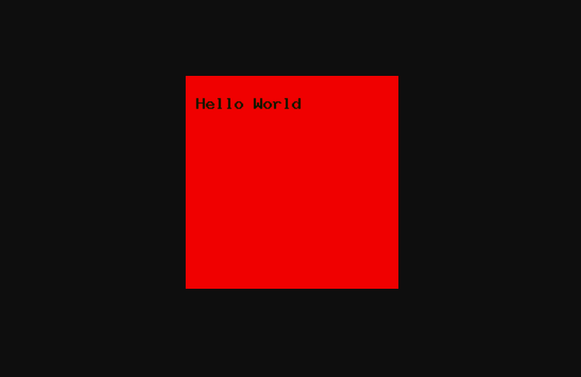
Creating Image
1. content-Type :
To send content-Type header to the browser with appropriate content type for the kind of image being create.
header(‘Content-Type:image.jpeg’);
2.Creating Image
We can create an image in PHP using imagecreate() function.
Syntax $image=imagecreate(width,height)
3.imagecolorallocate() function:-The imagecolorallocate() function is an inbuilt function in PHP which is used to set the color in an image. This function returns a color which is given in RGB format.
Syntax:
imagecolorallocate ( $image, $red, $green, $blue )
E.g
<?php
header ("Content-type: image/png");
$a = ImageCreate (200, 200);
//imagecreate(x_size, y_size);
$bg = ImageColorAllocate ($a, 240, 0,0);
//imagecolorallocate(image, red, green, blue)
$txt_color = ImageColorAllocate ($a, 0, 23, 0);
ImageString ($a, 10, 10, 18, “Hello World", $txt_color);
//bool imagestring( $image,$font, $x, $y, $string, $color )
imagepng($a);
?>

Slide 28
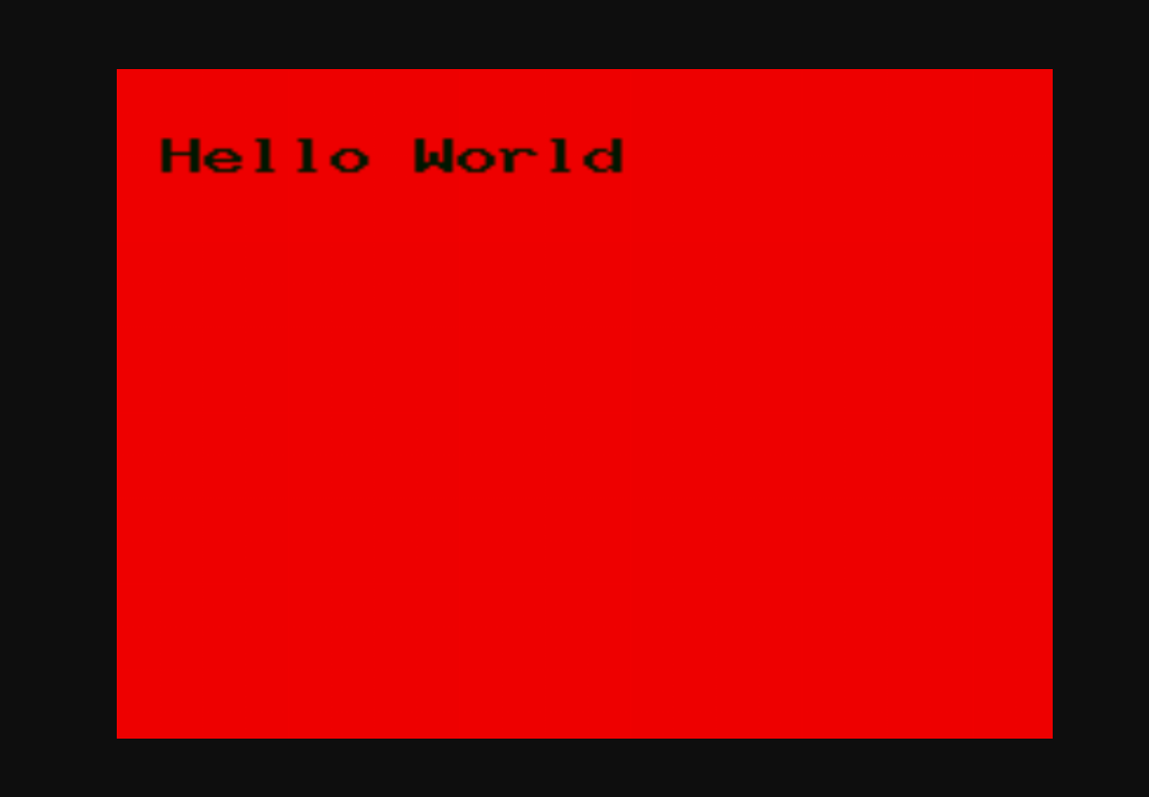
Scaling Images:-
Scaling an image means making the image either smaller in size or larger in size than original.
Using PHP we can resize or rescale the image using the function Imagescale().
<?php
$a = ImageCreate (200, 200);
//imagecreate(x_size, y_size);
$bg = ImageColorAllocate ($a, 240, 0,0);
//imagecolorallocate(image, red, green, blue)
$txt_color = ImageColorAllocate ($a, 0, 23, 0);
ImageString ($a, 10, 10, 18, "Hello World", $txt_color);
//bool imagestring( $image,$font, $x, $y, $string, $color )
// Use imagescale() function to scale the image
$img = imagescale ( $a, 700, 500 );
// Output image in the browser
header("Content-type: image/png");
imagepng($img);
?>

Slide 29
Creation of PDF document
FPDF is an open source library which is used for creating a PDF document.
To use this inside php code we need to download FPDF file from official website.
And then copy fpdf file and font folder and paste where the code is saved.
Features of fpdf,
1)It is an open source package, hence freely available on internet
2)it provides the choice of measure unit,page format and margins for pdf page
3)it provides page header and footer management.
4)It provides automatic page breaks to the pdf document
5)it provides the support for various fonts,colors,encoding and image formate.
<?php
require('fpdf.php');
$pdf=new FPDF();
$pdf->AddPage();
$pdf->SetFont('Arial','B',16);
$pdf->Cell(60,10,'Hello PHP World!');
$pdf->Output();
?>

Slide 30
require('fpdf.php');
This line includes our FPDF class that we need to create the PDF file.
$pdf=new FPDF();
This line creates a new instance of the FPDF class which will be binded to $pdf
$pdf->AddPage();
This line tells FPDF to add a new page to the PDF file; obviously we need one page so we will call this function once.
$pdf->SetFont('Arial','B',16)
This line tells the FPDF class to change the font to Arial, bold, and 16pt size
$pdf->Cell(60,10,'Hello PHP World!');
This line is just like the “echo” of PHP, the text fields in PDF files are just sort of rectangles with text in them, so we want the width of 4, pt. and a height of ,pt., the third value is the text to be written in that rectangular box.
`$pdf->Output();`
Our final line, which pretty much means: “we're done, show us our PDF!”

